Slide 1
Tutorial 5: GDB, Make
CS 108
Spring, 2023-24
TA: Saksham Rathi

Slide 2
Compiling C and C++ files through terminal
To compile C and C++ files through the terminal, we typically use the gcc (GNU Compiler Collection) for C files and g++ for C++ files.
gcc -o output_file input_file.c: gcc is the compiler. -o specifies the executable file name, input_file.c is the file to be compiled.
g++ -o output_file input_file.cpp: g++ is the compiler. -o specifies the executable file name, input_file.cpp is the file to be compiled.
Multiple files can be compiled into a single executable using g++ -o output.o file1.cpp file2.cpp file3.cpp
Multiple object files can be linked together using: g++ -o linked_executable file1.o file2.o file3.o
Some common flags:
-Wall: Enable most warnings
-std=c++20: Use C++20 standard
-g: Generate debugging information
-O2: Optimize code

Slide 3
Make

Slide 4
Introduction to Make
Makefiles are generally used to help decide which parts of a large program need to be recompiled.
So, basically it simplifies project management. For large project with minimal changes, we need not compile the entire project again (it might even take few hours to do so!). So, make automatically compiles those parts where we have made some changes.
It also gives us a brief overview of the project structure and dependencies. So, if any file’s dependencies are changed, that file will be recompiled.
Make can also be used beyond compilation too, when we need a series of instructions to run depending on what files have changed.
Cmake: Open-source cross platform family to tools to build software.

Slide 5
Installation of Make on different OS
MacOS: Open terminal and type: “brew install make”
Windows: https://stackoverflow.com/questions/32127524/how-to-install-and-use-make-in-windows
Linux: https://www.geeksforgeeks.org/how-to-install-make-on-ubuntu/

Slide 6
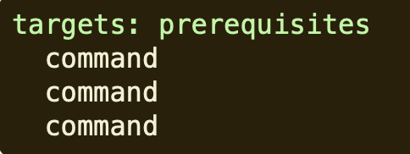
Syntax of Makefiles
Targets are file names which will be ready after the commands get executed. They are generally executables or binary files. If we have more than one file targets, separate them by spaces.
Prerequisites are the dependencies for the target. They need to exist for the commands to run. If we have more than one file dependencies, separate them by spaces.
Commands are the actions that need to be carried out. They are only carried out if the prerequisites are changed or the targets do not exist. These commands need to start with tab not with spaces. Make relies on timestamps, so the commands will run if targets have older timestamps that prerequisites.

Slide 7
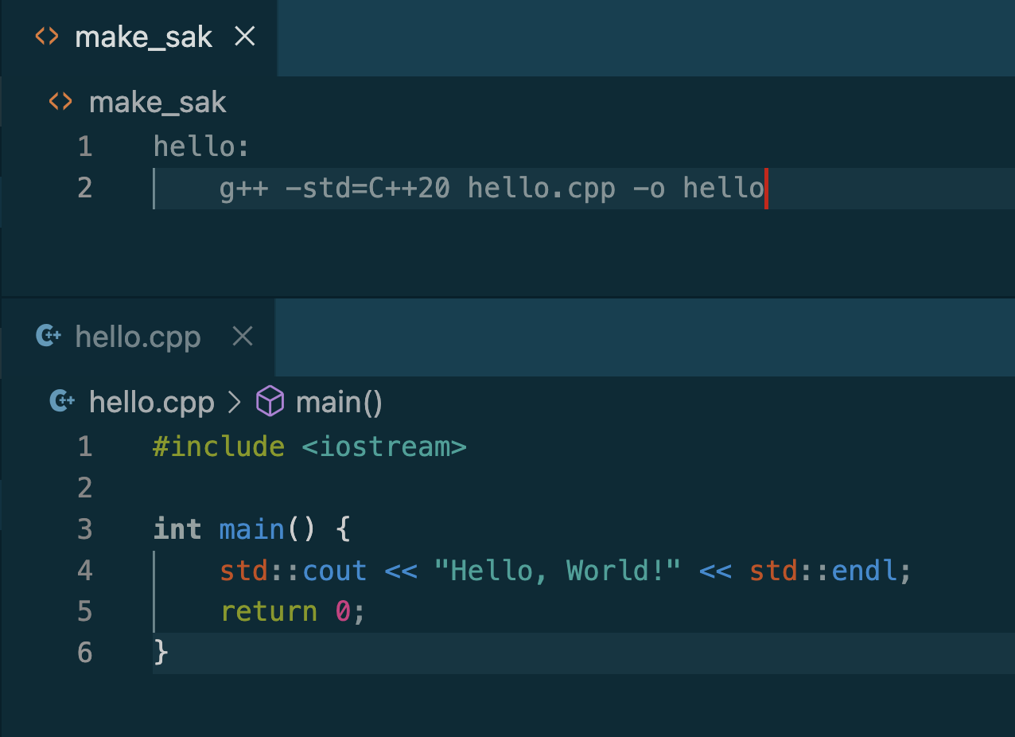
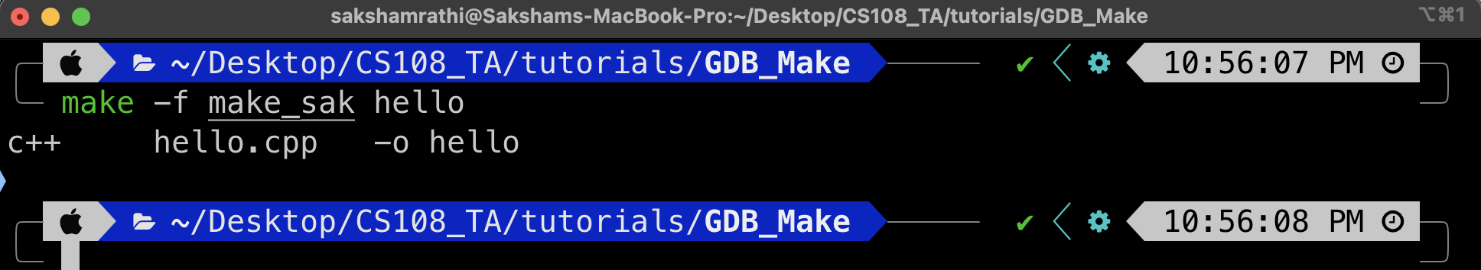
Naming of Makefiles
“make” command looks for the presence of Makefile in the same directory.
It tries the following names in order:
GNUmakefile (For makefiles specific to GNU Make)
makefile
Makefile (Most preferred)
If you wish to use a different name, then just use make -f

Slide 8
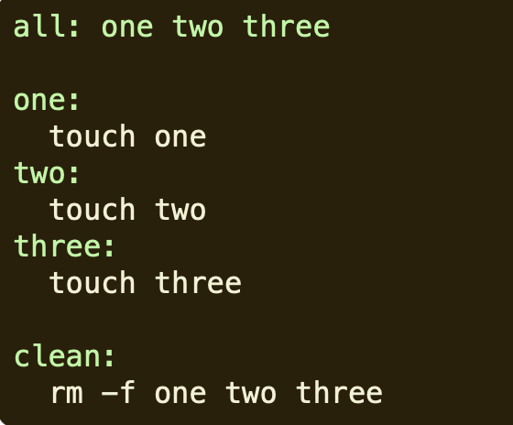
Targets
Make by default runs the first target.
If you wish to make multiple targets and run all of them simultaneously, then you can use all target. Since, this is the first rule listed, typing “make” on the terminal without specifying any target will run this.
Clean is often used as a target that removes output of other targets. It is a target that is not the first, so will not run unless you explicitly type “make clean” on the terminal.

Slide 9
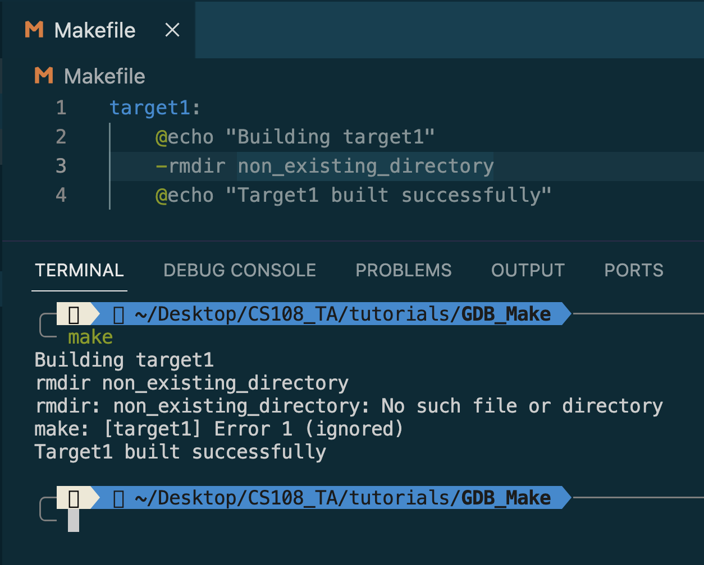
Handling Errors and Other Flags
Add -k when running make to continue running even in the face of errors. Helpful, if you wish to see all the errors of make at once.
Add a “-” before a command to suppress the errors.
Add -i with make to have this happen for every command.

Slide 10
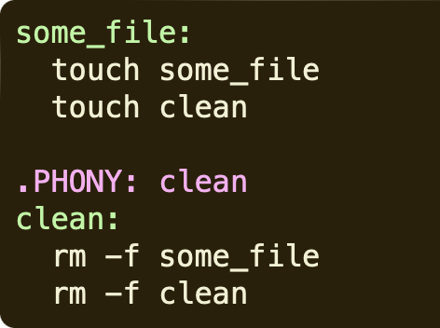
Phony Target
Adding a .PHONY to a target will prevent Make from confusing the target with a file name.
In the example shown, the target “clean” will still run, even if the file “clean” is created.
Additionally, phony targets have names that are rarely file names and in practice, many people skip this.

Slide 11
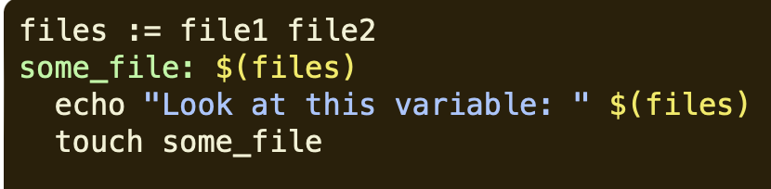
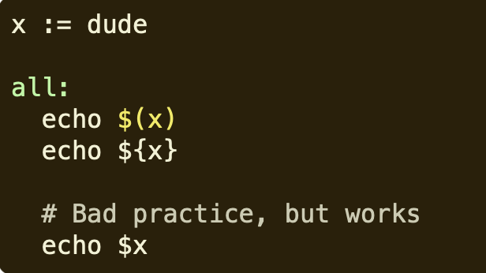
Variables
Variables can only be strings.
Typically, “:=” is used, but “=” also works.
Variables are referenced as $() or ${}.
Single or double quotes have no meaning to Make, they are simply characters assigned to the variables.

Slide 12
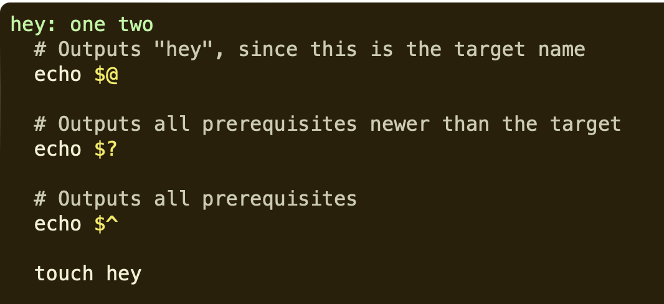
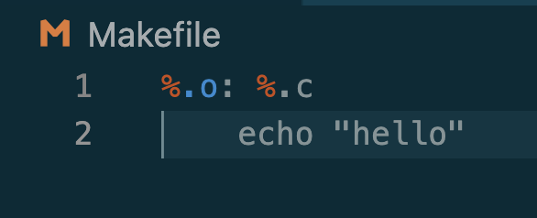
Automatic Variables and WildCards
$@, $? and $^ are the automatic variables, see the example on how to use them.
Both * and % are the wildcards used in Make.
* searches for filenames in our system. For example *.c will match all filenames with the extension .c
% is used in various cases, here for all .o files, the corresponding .c file is searched for and the “hello” is printed.

Slide 13
Implicit Rules
Make loves C compilation, so it has some inbuilt automatic rules to make our work easy. (At times, things get confusing using these rules!)
The important variables used by implicit rules are:
CC: Program for compiling C programs, default cc
CXX: Program for compiling C++ programs, default g++
CFLAGS: Extra flags to give to the C compiler.
CXXFLAGS: Extra flags to the C++ compiler.
CPPFLAGS: Extra flags to give to the C preprocessor.
LDFLAGS: Extra flags to give to compilers when they are supposed to invoke the linker.
n.o is made automatically from n.cc or n.cpp with a command of the form $(CXX) -c $(CPPFLAGS) $(CXXFLAGS) $^ -o $@

Slide 14
GDB
GNU DeBugger

Slide 15
Debugging
Process of finding compile and run-time errors
Compile time errors:
Missing semicolons (after python practice!)
Wrong variable names
Out of scope variables
Assigning strings to integer variables. (Rare?)
Didn’t pass arguments to functions.
Some others left? GDB can handle all of them!
Run-time errors:
Illegal use of pointers
Freeing memory that was already freed.
Array index out of bounds
Dereferencing memory that has not been allocated.

Slide 16
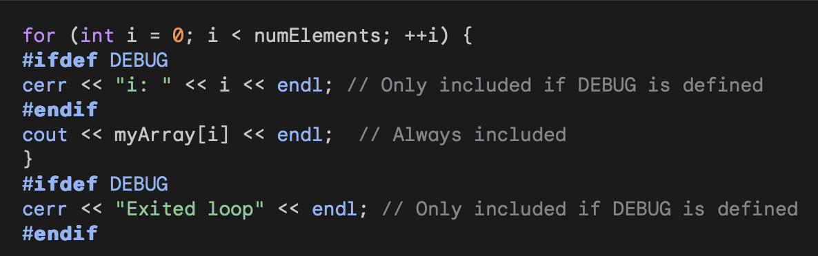
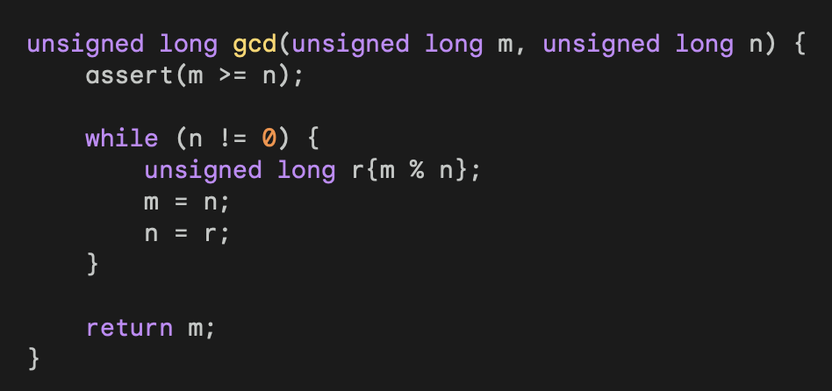
Alternatives to GDB
Add output statements to the code. (My favourite!) Better to use endl instead of “\n”, because “endl” causes a flush operation, which means any data to be printed is directly sent to the terminal. Usage: cout << “debugging is necessary ” << x << endl;
You can even set compile time symbol DEBUG. g++ -g -c -DDEBUG myProgram.cpp. This will make sure that the DEBUG sections will be included while executing the code.
Assertions: “Programming with defense”. Include <assert.h> in C++ to use this. Program fails with an informational message whenever the assert condition fails. If compile time symbol “NDEBUG” is used, then assertion is commented.
VS Code Inbuilt Debugger (Install Extensions)

Slide 17
How to start GDB?
Compile your program with the -g compile flag. This helps in debugging.
g++ -g -o try try.cpp
gdb try
Starts the debugger for this program, but the program does not start running.
gdb: Starts the debugger but without any file.
gdb –help: Shows the possible command line options.
quit: Exit gdb, q will also work.

Slide 18
Breakpoints
To stop the program at different points in its execution, we use breakpoints.
To specify a breakpoint upon entry to a function, we use: “break function” (stops just before the start of the function), “break bug.c:function”(stops before the function present in a particular file), “b function” (b = shortcut for break)
“break 26” will set a breakpoint at line number 26 of the file.
To list current breakpoints, type “info breakpoints”. Breakpoints will be given some numbers(id’s). They can be deleted using “delete <id>”
Breakpoints can also made to be triggered only when certain conditions are met. “break <line/function> if <condition>”
break +offset: will set a breakpoint after offset lines from current spot.
tbreak: temporary break, remove when reached
rbreak regex: break on all functions matching regex
Ignore n count: ignore breakpoint n count times.

Slide 19
Execution Control
(gdb) run: Starts running the program.
continue/c: Continue running after a breakpoint.(run starts from the beginning of the program, whereas this starts from the breakpoint itself!)
next/n: Execute next line stepping over function calls.
step/s: Execute next line stepping into function calls, if any.
With all these three, we can even specify the number of times, they are supposed to be run.
(gdb) help: Lists the possible topics we can ask for.

Slide 20
Program Stack
backtrace/bt: Prints the current contents of the stack. Also prints the arguments to the function calls
up: Helps move one step up in the stack i.e. from a function to it’s caller.
down: Helps move one step down in the stack, i.e. from a function to it’s callee.
info args: Print the arguments of the current function.
info locals: Print the local variables of the current function.

Slide 21
Printing Variables
display <variable>: Print the values of the variable, every time the program stops at a breakpoint.
print <variable>: Prints the value of the variable at that particular breakpoint. (Shortcut: p)
We can also use print to evaluate expressions/function calls, reassign variables and more… Example: print strlen(text)
list: Shows next ten lines of the source code
show dir: Shows current source path.

Slide 22


